Slide 1
Oregon Resource Allocation Advisory Committee
Advisory Committee Meeting
June 15, 2023

Slide 2

ORAAC Members
Make sure your full name is shown in Zoom
  Click Participants
  Hover your mouse over your name
  Click “more” button (three dots)
  Click Rename
  Enter your name in the pop-up box
  Click Change
You will be invited to join as a panelist
  Accept the invitation when it pops up

Slide 3
Spoken Language Interpretation
Click the globe to enable interpretation options.
Select the language.
You can choose to hear the original audio at a lower volume or select “mute original audio” to stop hearing the original audio.

Slide 4

ASL Interpretation
Select “gallery view” in upper right corner
Click the interpreter’s video
  Select the “more” button (three dots)
  Select “Pin Video”
Be sure to pin video for both interpreters

Slide 5
Meeting Resources
If you need support, we have:
Simultaneous Spanish language interpretation
Technology support
Note taker
If you have a need, contact Kristen Darmody at: 971-888-3358
Please note that this meeting will be open to the PUBLIC
1. The general public may be in attendance
2. The meeting summary will be posted to OHA’s website
Notes:
Lisa can be main point of contact to triage needs and connect folks to the right person during the meeting
Let committee know that anything entered into the chat is subject to disclosure under public records law

Slide 6
Purpose
Close the deliberation process to begin drafting final recommendations

Slide 7
Agenda
Welcome
ORAAC Review
Review: Written Public Comment & Community Conversations
Public Comment
Break
Examples of Multi-criteria Approaches
Discussion
Closing
Total 120 minutes (2 hours)

Slide 8
Working Agreements
Keep the patients and communities who have been marginalized by mainstream institutions, like the healthcare system, at the center of the discussion
Be mindful of paternalism in discussions about elders, people with disabilities, and BIPOC communities
Acknowledge the importance of all the services, supports, systems, and perspectives that are present in this committee
Be cognizant of how you speak and what you say so we can all understand one another
Recognize that participation and engagement looks different for everyone
Keep an open mind and come with a willingness to learn and to share
Move in the spirit of trust and love
Be clear in your communication
Notes:
Please add in place of the check-in question!

Slide 9
ORAAC Journey in Review
May 2022 - May 2023

Slide 10
May through July 2022
History, definitions, and current status of crisis care guidance in Oregon
ORAAC role and resources for members
  Develop meeting expectations
Review and explore principles in promoting health equity during resource constrained events
Patient led, patient-centered, and shared decision-making

Slide 11
August and September 2022
Presentations by Ruqaiijah Yearby, JD, MPH
  Structural discrimination and health inequity definitions, relationship to crisis standards of care
  Disadvantage indices
  Health justice
Presentation by Derick Du Vivier, MD
  Examples of structural racism and racial biases in medicine and disparate health outcomes
  Review of race correction in clinical medicine and equity impacts

Slide 12
October through December 2022
Presentation by Alyshia Macaysa:
  Pacific Islanders in the Pandemic: role of community as a system and pandemic impact
Triage definition and common approaches during a crisis
  Impact on health equity, with focus on survivability prediction tools
  Cultural values and community needs
  Ideal properties
Triage Approaches Subcommittee, first meeting
  Review Oregon’s Interim Crisis Care Tool

Slide 13
January through March 2023
Triage Approaches Subcommittee: explore triage options, including justification and drawbacks for each
  Expertise and consultation provided by Harald Schmidt, PhD, MA and Ruqaiijah Yearby, JD, MPH
Full ORAAC meetings:
  Introduce and discuss triage teams and data collection; develop draft ORAAC recommendations
  Review Triage Approaches Subcommittee process and work to date

Slide 14
April and May 2023
Review all triage options discussed by the Triage Approaches Subcommittee
  Review and identify potential benefits and harms
  Collect the full committee’s input on triage goal and commitments to hope and innovation
Review draft committee recommendations regarding triage team and data collection
Notes:
June: after committee members discussed something that each person needed from others in this space to participate, as well as what members want to provide for others to support their participation, committee members defined their own meeting expectations Throughout the duration of the committee meetings thereafter, these expectations have been elevated and centered as part of our discussions.
Reviewed the priniciples in promoting health equity as published by the OHA, and committee members explored and informed what needs to change

Slide 15
Reflection Question
What is something new you have learned on the committee from someone who has had a different experience or perspective than you?

Slide 16
ORAAC’s Final Work June 2023
Today: close the deliberation process to begin drafting final recommendations
  Understand the concerns, questions, and suggestions from members of the public as the committee closes its deliberation process
  Complete the introduction of triage options by providing examples of multi-criteria approaches
June 29: review final draft of ORAAC recommendations and input

Slide 17
Written Public Comment & Community Conversations
Review Input To Date

Slide 18
Public Input Regarding Crisis Care Triage Options
On May 23, 2023, the Oregon Health Authority (OHA) began requesting public input on crisis care triage options under consideration by the Oregon Resource Allocation Advisory Committee (ORAAC).
The document for public comment outlines the options for public input and is available in 12 languages on OHA’s website.
The public comment period closes on June 26.
All comments will be reviewed and considered by the OHA and a summary of public comments will be posted on the OHA’s ORAAC webpage in July 2023.

Slide 19
Example Comments (1 of 4)
Culturally Specific Communities
  Prevention is a priority to avoid pain, worry and anguish.
  Equitable chances caught my attention; resources should be distributed equally and impartially; discrimination should be avoided.
  There are barriers that create a huge gap between my community and resources available; the disconnect is due in part to language barriers; interpretation and translation of written materials are needed.
  Urgent resources and care for those with the most serious conditions should be given priority.
  Processes should be clear, smooth and easily understood and available in multiple languages.

Slide 20
Example Comments (2 of 4)
Disability or Aging
  This work must consider the intrinsic biases and oppressive factors that exist in our current health care infrastructure; the disadvantage assessment is an essential component and should be included in the final triage approach.
  Under crisis and with limited preparedness, triage approaches typically devalue age and disability.
  Neither age nor ability should be used as criteria in the allocation of scarce resources; any standard that applies these criteria is opposed.

Slide 21
Example Comments (3 of 4)
Hospitals/Inpatient Care
  Hospitals should be given flexibility to do what they can with the limited information and resources they have in the moment of an emergency.
  Health care providers deserve support and protection when they show up to do work on behalf of communities in an emergency.
  Combinations of triage criteria may be developed prospectively, though different crises may warrant different triage approaches to be used.
  Care must be taken to ensure that criteria are not discriminatory in violation of the law.
  A robust state infrastructure is needed to develop, manage and activate a triage model including staff training and the standardizing and streamlining of data collection.

Slide 22
Example Comments (4 of 4)
Community-based Clinics/Public Health
  A patient’s chance of survival if they don’t receive the scarce resource should be assessed and factored into resource allocation decisions.
  Rural communities with limited access to a single critical access hospital with few hospital beds should be considered as part of crisis care guidance. For example, supplies may be an issue during emergency situations specific to freeway closures.
  Appreciate the framework suggested, the definition for triage, and the suggested options for focusing care.

Slide 23
Community Conversations
The ORAAC project team hosted two sessions of community conversations.
These sessions focused on engaging communities most impacted by health inequities and understanding their values, challenges they foresee, and ideas when it comes to crisis care.
The concerns and experiences shared in the sessions apply to both routine health care, which can worsen health inequities prior to a disaster, and to crisis care.

Slide 24
Community Conversations
Community systems trying to fill the gaps in access to healthcare for communities that experience health inequities are always in a state of navigating crises and limited resources.
Non-English language accessibility is a significant challenge that healthcare must address to treat impacted communities.
Building trust between impacted communities and healthcare is important. Valuing and respecting the expertise of community leaders is important to better serve impacted communities.
There are a number of issues related to trust and listening to patients that healthcare must address.
End of life planning is not the norm in some impacted communities, and having conversations to end treatment can be difficult.

Slide 25
Public Comment

Slide 26
Break

Slide 27
Multi-criteria Approaches

Slide 28
Review: Triage in Crisis Care Guidelines
During crisis care, “triage” refers to the prioritization process to determine which patient(s) will receive life-saving resources when there are not enough for everyone who needs them
  Triage is also called “resource allocation”
ORAAC focus: provide recommendations to OHA regarding how to distribute limited, life-saving health care resources during an emergency or disaster when there are not enough for everyone
Notes:
Data collection, review, iterative learning and improvement
October slide?

Slide 29
Multi-Criteria Triage Options
Crisis care guidelines often utilize multiple criteria for resource allocation (called a “multi-criteria approach”) rather than a single decision-making factor
Choices to consider when choosing a multi-criteria approach include, but are not limited to:
  which criteria to include;
  what their underlying justification is;
  what “weight” (or importance) is given to each of the criterion; and
  the sequence in which they are applied.
Notes:
Slide 71 from community engagement slide deck

Slide 30
Example steps for any crisis care triage approach:

Slide 31
Pre-triage Steps
Confirm that patient requires the identified resource (e.g., meets admission criteria to the intensive care unit)
Confirm patient preferences for care
Determine whether adequate resources exist to serve all patients
  If not, move to crisis care triage

Slide 32
General Crisis Care Triage Steps
If there are not enough resource(s) for everyone who needs and desires the scarce resource, initiate the following four steps of crisis care triage:
1.
Assess patients based on triage criteria
2.
Assign and confirm triage priority score
3.
Apply tiebreaker if needed, and allocate resource
4.
Waiting list and reevaluation
Notes:
Before the triage steps:
Confirm patient requires the resource (e.g., ICU admission, ventilator)
Assess patient preferences: confirm whether patient’s care preferences align with the resources that have been determined they need for survival
If yes, move into

Slide 33
Triage: Step 1
Assess patients based on established triage criteria
  For example, assess likelihood of survival to hospital discharge (“survivability”) based on:
    Triage team (clinician) prognosis assessment; or
    SOFA, mSOFA; or
    Other survivability prognosis tool

Slide 34
Triage: Step 2
Assign triage priority score based on step 1
  For example, based on prognosis for hospital survival
  Patients with highest likelihood to survive hospitalization receive priority first
PAUSE and review
  Is the scoring clinically consistent?
  Are there potential biases?

Slide 35
Triage: Step 3
Equal priority resolution process (tiebreaker):
  In the case that two or more patients have the same triage priority score:
    If one of the patients is already using the resource, the resource stays with that patient (e.g., per Oregon’s Interim Crisis Care Guidance)
    If not, apply another tiebreaker (e.g., equitable chances)
Confirm resource allocation decision and communicate the triage priority score to the patient and clinical team
Resource is then allocated to the appropriate patient

Slide 36
Triage: Step 4
Use a resource waiting list and interval re-evaluation
  For patients who receive lower priority scores and do not receive the needed resource during allocation
  Continue ongoing hospital care without the elevated resource
  Place patients who receive lower priority scores on a waiting list for the needed resource
  Reassess priority as resources become available
  Re-triage using steps 1-3

Slide 37
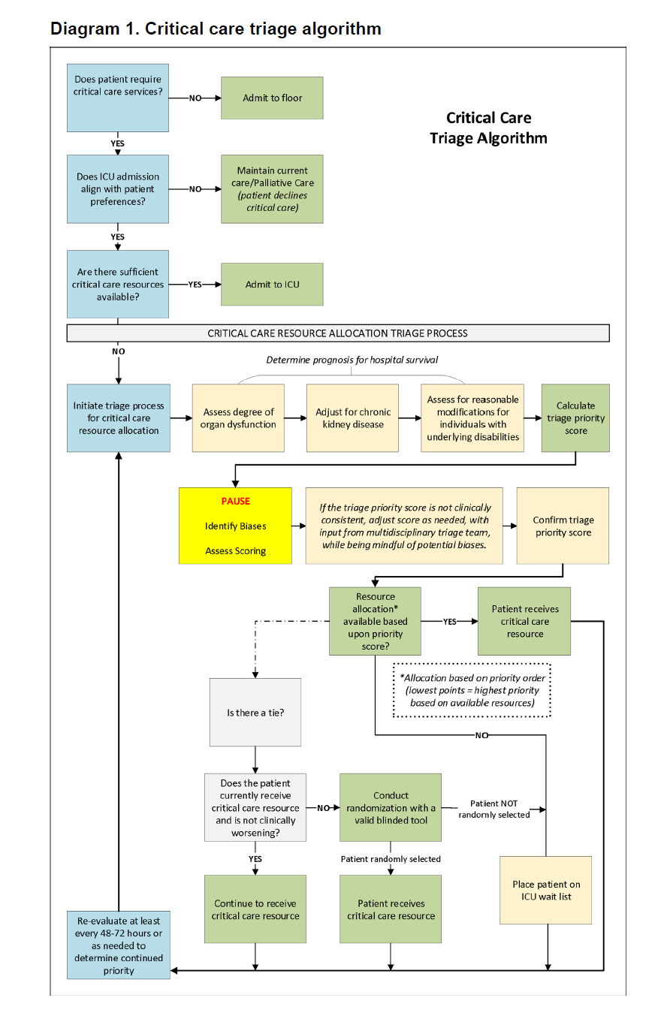
Oregon Interim Crisis Care Tool: Triage Algorithm
Critical care triage algorithm (steps) based on survivability tool and additional equity corrections
Full triage flow chart/algorithm available on page 9 as shown here →
  Document available in 12 languages: https://www.oregon.gov/oha/Pages/ORAAC-Resources-Materials.aspx
Forthcoming updates to this tool will be informed by ORAAC, public

Slide 38
Examples of Multi-criteria Approaches
For Committee and Public Input
Clinician Prognosis + Equitable Chances
Clinical Prognosis, Life Cycle, and Equitable Chances
Clinical Prognosis, Essential Worker, Multiplier Effect, and Equitable Chances
Notes:
New

Slide 39
Example A:
Clinician Prognosis + Equitable Chances
Step 1: Clinician Prognosis: assess patient’s chance to survive hospitalization. Group 1 gets highest priority for the resource, and Group 3 gets lowest priority for the resource:
Step 2: if there are not enough resources for patients in the same prognosis group, apply equitable chances criterion
Priority Group 1 | Priority Group 2 | Priority Group 3
≥ 90% chance of hospital survival | all others (e.g., 11-89% chance survival) | ≤ 10% chance of hospital survival
Notes:
triage protocols should be applied to all who need the scarce resource, not just those suffering from conditions related to the pandemic/disaster/emergency at hand.
Slide 73 (“Example” instead of Option”) community engagement slide deck

Slide 40
Example A: continued
Equitable chances criterion:
  Determine the disadvantage score based on the disadvantage index for their geographic residence
  Assign additional equitable chances weighting for patients based on their level of disadvantage, proportionate to impact (as measured by disadvantage index)
  Complete the automated, weighted randomization process (a drawing) using available software to determine who receives the resource

Slide 41
Example A: Who is Prioritized?
Patients who have the greatest chance to survive hospitalization (a greater than or equal to 90% chance) based on clinician prognosis would be the first group prioritized; and
Patients within this group who have experienced the greatest disadvantage would have the highest chance of being prioritized in front of other patients who have experienced the least disadvantage, proportionate to the impact the emergency had on the disadvantaged group

Slide 42
Example B: Clinician Prognosis, Life Cycle*, and Equitable Chances
Step 1: Clinician Prognosis: assess patient’s chance to survive hospitalization. Group 1 gets highest priority for the resource, and Group 3 gets lowest priority for the resource:
Step 2: if there are not enough resources for patients in the same prognosis group, patients who are in an earlier life stage (based on age) receive priority for the resource
Priority Group 1 | Priority Group 2 | Priority Group 3
≥ 90% chance of hospital survival | all others (e.g., 11-89% chance survival) | ≤ 10% chance of hospital survival
*OHA has significant concerns with using this option
Notes:
Note: OHA has significant concerns with using this option based on the drawbacks we have learned and explored as a committee. Further public input will be helpful in order to fully evaluate this option

Slide 43
Example B: continued
Example life stages assignments:
  Childhood: 0-17 years old
  Early Adulthood: 18-39 years old
  Middle Age: 40-64 years old
  Older Adults: 65+ years old
Step 3: Second tiebreaker: in the event there are patients in the same prognosis group and same life stage, apply equitable chances criterion to determine priority

Slide 44
Example B: Who is prioritized?
Patients who have a greater than or equal to 90% chance to survive hospitalization based on clinician prognosis would be the first group in line for the needed resource;
Patients in this group who are defined as being in an earlier life stage would have priority over patients in an older life stage; and
Patients with the same life stage who have experienced the greatest disadvantage would have the highest chance of being prioritized in front of other patients in the same life stage who have experienced the least disadvantage, proportionate to the impact the emergency had on the disadvantaged group

Slide 45
Example C. Clinician Prognosis, Essential Worker, Multiplier Effect, and Equitable Chances
Step 1: Triage Team determines prognosis for survival to hospital discharge for all patients:
Step 2: Prioritize based on:
  Essential worker verification and/or multiplier effect verification
Step 3: Tie breaker: apply equitable chances weighted randomization
Priority Group 1 | Priority Group 2 | Priority Group 3
≥ 90% chance of hospital survival | all others (e.g., 11-89% chance survival) | ≤ 10% chance of hospital survival
Notes:
triage protocols should be applied to all who need the scarce resource, not just those suffering from conditions related to the pandemic/disaster/emergency at hand.

Slide 46
Example C: Who is prioritized?
Patients who have a greater than or equal to 90% chance to survive hospitalization based on clinician prognosis would be the first group in line for the needed resource;
Patients in this prognosis group who have an occupation that meets criteria for essential worker or multiplier effect would have next priority; and
Patients with the same occupation-related priority who have experienced the greatest disadvantage would have the highest chance of being prioritized in front of other patients with the same prognosis and occupation-related priority who have experienced the least disadvantage, proportionate to the impact the emergency had on the disadvantaged group

Slide 47
Feasibility
In a major health emergency, ease of implementation is an important consideration
Resource allocation approaches, such as the examples previously described, can all be implemented readily via a methodological approach known as Categorized Priority System (also known as a reserve system)
This custom-made, free-of-charge software has been developed to facilitate implementation of resource allocation processes

Slide 48
Questions?

Slide 49
Discussion
Based on the public comment and community conversations shared, what changes or additions would you make to the input you provided OHA?
Based on the examples of multi-criteria approaches shared, what changes or additions would you make to the input you provided OHA?

Slide 50
Next Steps and Closing

Slide 51
Thank You

